Slide 1
Reasoning
How’s that different from problem solving?

Slide 2
Reasoning
Reasoning – cognitive process we use to make inferences from knowledge and draw conclusions.

Slide 3
Reasoning
Inductive Reasoning
Deductive Reasoning

Slide 4
Inductive Reasoning
Drawing inferences about unknown instances using our knowledge about specific instances.

Slide 5
Types
General Induction – generalize from known instances to all instances
  Mastermind!

Slide 6
Types
Research on general induction began in earnest during the 1950s. In a groundbreaking study, investigators devised a task much like the game Mastermind: from feedback provided by the experimenter, participants had to discover rules for the game, thereby making general inductions.

Slide 7
Types
The experimenters varied the (unstated) rules, and found that simple rules (such as “red”) were very easy for participants to discover, conjunctive rules (such as “red and square”) were a little harder, and disjunctive rules (such as “red or square”) were difficult.

Slide 8
Types
Negative rules, such as “not red,” were very difficult to discover, and disjunctive negative rules, such as “not red or cross,” were the most difficult of all.

Slide 9
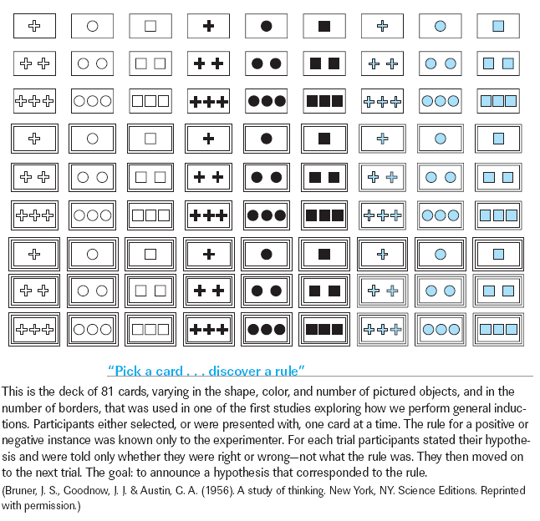
General Inductions
Chapter 10

Slide 10
Types
Specific Induction
  To assume that if one member of a category has a particular feature another member will also have it is to make a specific, category-based induction.
  Explains the typicality effect – you induce to similar members because those things are typical

Slide 11
Types
A model of category-based induction, known as the similarity-coverage model, has been developed.
“Coverage” is defined as the average maximum similarity between the instances in the premise and each exemplar of that category in the conclusion.

Slide 12
Deductive Reasoning
Categorical Syllogisms
Conditional Syllogisms
Errors in Deductive Thinking
Form Errors
Content Errors
Theories of Deductive Reasoning
Linguistic versus Spatial Basis

Slide 13
Deductive Reasoning
Deductive reasoning tasks are one of the fundamental tools used by cognitive psychologists in the quest to understand human rationality.
One tool used to study deductive reasoning is the syllogism, an argument that consists of two statements and a conclusion.

Slide 14
Example
Fred is the brother of Mary. Mary is the mother of Lisa.
Deductive
  Fred is the uncle of Lisa.
Inductive
  Fred is older than Lisa.

Slide 15
Deductive Reasoning
So how do we study this type of reasoning?
  Syllogisms – argument of two statements and a conclusion.

Slide 16
Syllogisms
  Categorical – relations between two categories of things
    All poodles are pets.
    All pets have names.
    Therefore, all poodles have names.

Slide 17
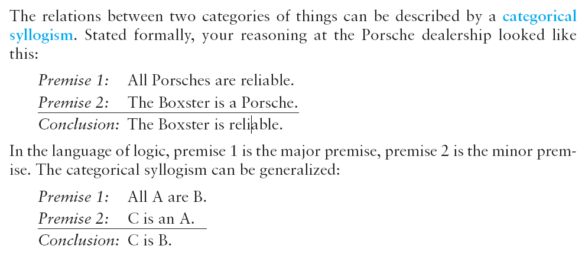
Categorical Syllogisms
Chapter 10

Slide 18
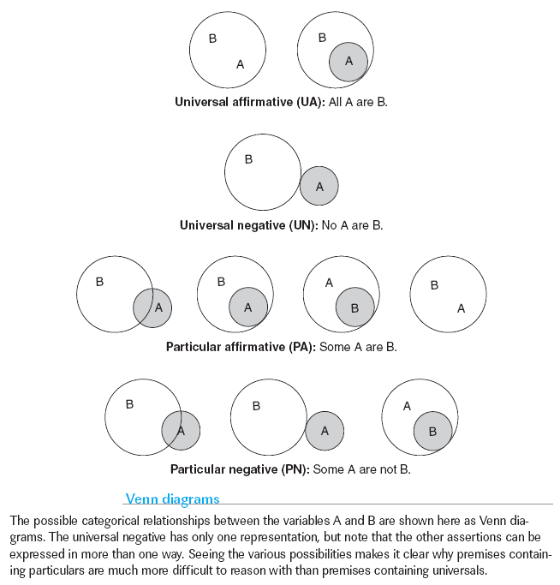
Categorical Syllogisms
Chapter 10

Slide 19
Syllogisms
The occurrence of an event may be conditional on the occurrence of another: this relationship between events can be described in a conditional syllogism.
The first premise of a conditional syllogism is a statement of the form “if p, then q,” where p is some antecedent condition and q is some consequent condition.

Slide 20
Syllogisms
Antecedent – the if condition
Consequent – result of conditional (then)

Slide 21
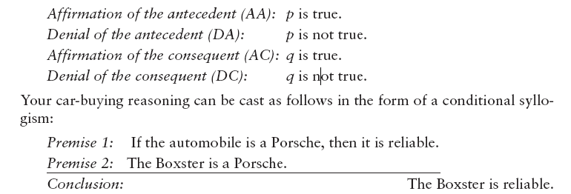
Chapter 10

Slide 22
Syllogisms
Modus ponens
  Rule of logic stating that if a conditional statement is true and antecedent is true then the consequent is true
  Given A, then B is true.
  People usually good at understanding these.

Slide 23
Syllogisms
Modus tollens
  Rule of logic stating if conditional is true and consequent is false, then antecedent is false.
  If B is false, so is A.

Slide 24
Wason Selection Task
Rule: Vowel on one side of the card then even number on other.
Which ones do you have to turn over to judge the rule?

Slide 25

Wason Selection Task
E
K
4
7
1 2 3 4

Slide 26
Wason Selection Task
90 choose E (odd number would break the rule)
60 choose 4 (no reason to)
25 choose 7 (also needed)
15 choose K (no reason to)

Slide 27
When are we good?
When the material is meaningful.
Rule: if person is drinking beer, they are over 19.

Slide 28
Wason Selection Task
Beer
Coke
16
19
1 2 3 4

Slide 29
Errors in Thinking
Form errors – A common form error in categorical reasoning is to accept a conclusion as valid if it contains the same quantifier—“some,” “all,” or “no”—as appears in the premises.
  Two types:

Slide 30
Form Errors
This error is called the atmosphere effect: the use of these terms in the two premises conveys an overall mood, or atmosphere, that leads participants to accept a conclusion containing the same term.

Slide 31
Form Errors
This problem is defunct!
  Some women are lawyers.
  Some lawyers are men.
  Therefore, some women are men.

Slide 32
Form Errors
Matching Bias – accepting a conclusion as valid if it has the same syntax of terms of premise.

Slide 33
Errors in Thinking
Content Errors – content of syllogism overly influential
  The belief-bias effect—the tendency to be more likely to accept a “believable” conclusion to a syllogism than an “unbelievable” one—is perhaps the most prevalent content effect studied in deductive reasoning.

Slide 34
Content Errors
All lawyers are human.
All Republicans are human.
  Therefore, some lawyers are Republicans.
Logically this isn’t true but in real life it is.

Slide 35
So why?
One prominent class of theories of deductive reasoning proposes that deduction depends on formal rules of inference akin to those of a logical calculus.
In this view, we evaluate deductive syllogisms by constructing and verifying a “mental proof” in working memory.

